Slide 1
Spotify Playlist Analysis
Group 10: Kath Fillman, Perrie Gryniewicz, Nicole Kleman, Sam Konstan

Slide 2

Our Goals
A genre is a style of music that contains certain characteristics
Genres are useful to both people and music. They serve as points of comparison between both songs and artists as well as ways to self-identify your tastes
We wanted to see if songs grouped by similar attributes are similar to existing genres. That is to say- is genre quantifiable?

Slide 3
Dataset
The dataset includes variables such as the artist, song title, duration, rather or not it was explicit, release year, danceability, energy, key, and loudness
There are 18 variables with 2000 unique observations which make up the top 2000 tracks on Spotify from 2000-2019
This dataset comes from Kaggle: Top Hits Spotify from 2000-2019
Notes:
problem: we wanted to play specific genres in our playlists, but didn’t know the genres of songs. So, we grouped by genre per playlist. What is a genre anyway? it is based on vibes.
helps people categorize the songs that they like, self identify, point of comparison for songs and musicians
There was no classification based on genre, so we are making them

Slide 4
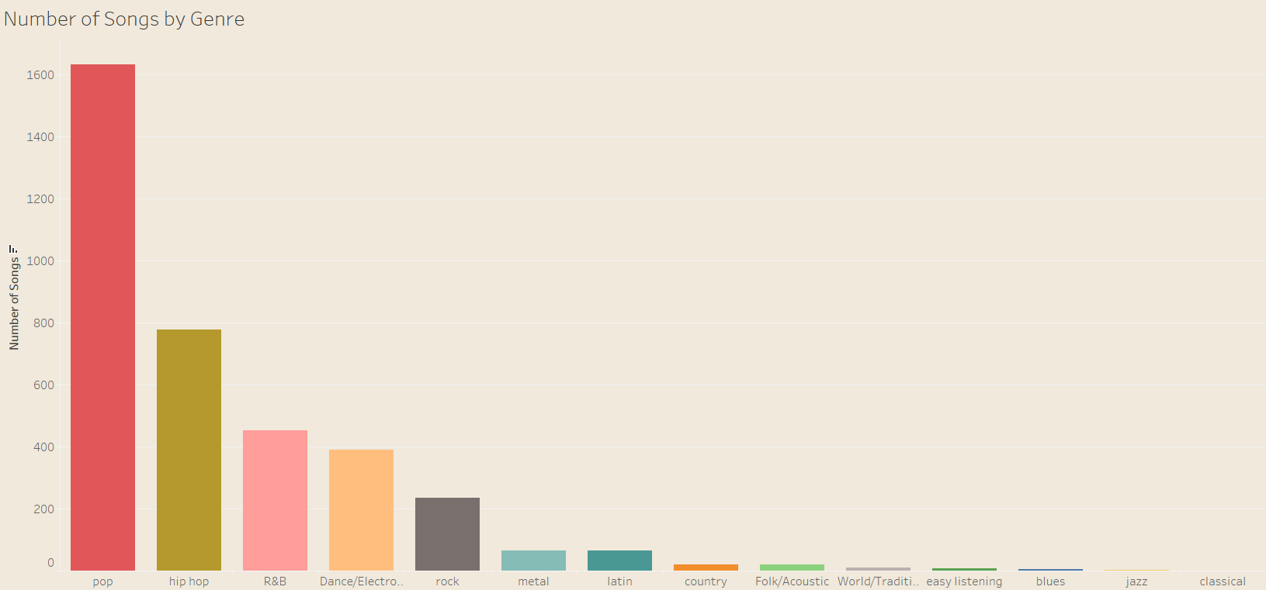
Base Truth Distribution of Genres

Slide 5
Challenges
Column types had different formats
This caused issues when trying to analyze artist & years
Variables not uniform so hard to compare
Need to do more data preprocessing to be able to compare these
Don’t know every song that exists
We would have to look up several songs to prove that they are similar
Preprocess to get more of a general knowledge of songs and when they were produced
This is tedious and timely making it a challenge
Artists tend to switch genres a lot throughout their careers which makes it difficult to scale what they aim for in a song
Most of the data is pop songs
Notes:
Perrie

Slide 6
Exploratory Data Analysis
Found numerous descriptive statistics for each categories:
Mode, scale, danceability, energy, speechiness, temp, duration (ms)
Duration included maximum, minimum, mean, standard deviation and skew
Found the amount of tracks associated with each artists
Found amount of tracks associated with each record label
These features allow us to progress through the project and continue learning about the data found

Slide 7
Our Approach
Data pre-processing, feature selection
Separate genres as labels
KMeans, Hierarchical to identify clusters
Assign clusters to genres and calculate cluster purities
Examine similarities to existing genre breakdowns
Notes:
How did the presenter solve the problem that was described?
What was/were the solution(s) that they have proposed?
What was so innovative about the proposed solutions?

Slide 8
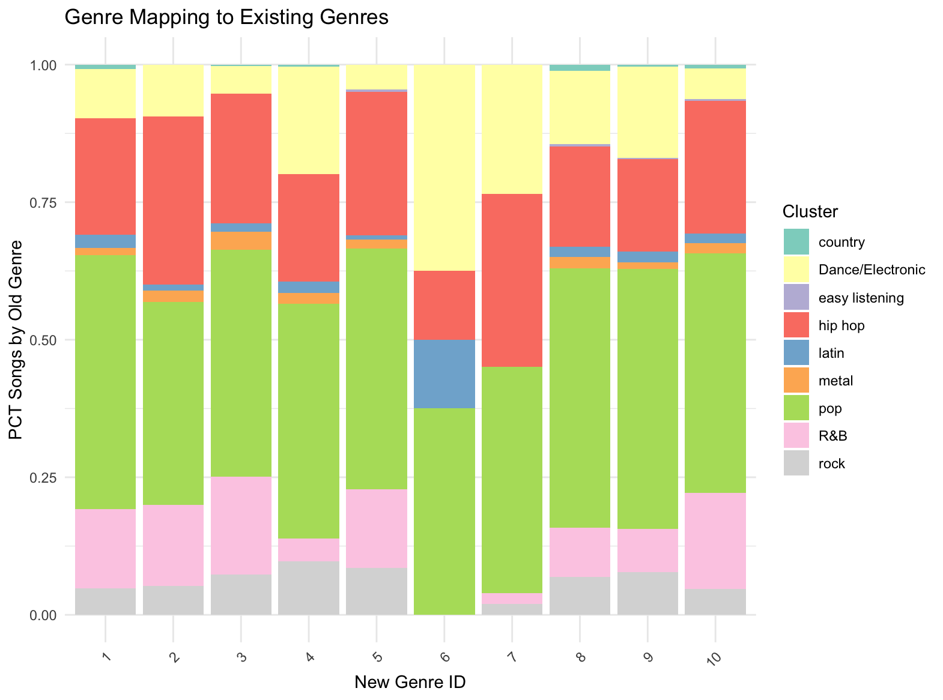
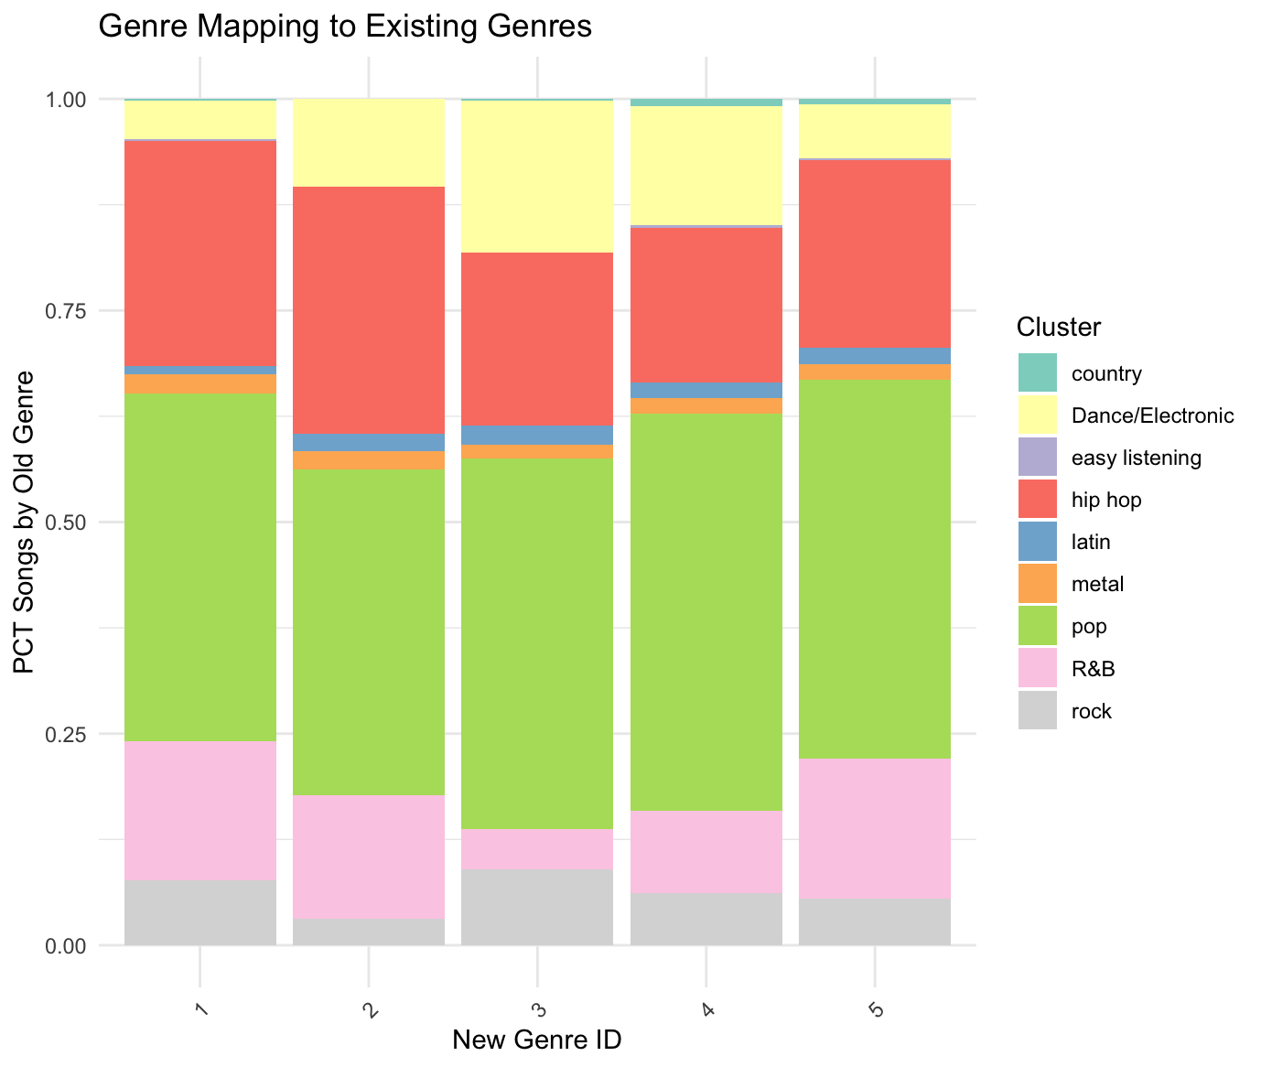
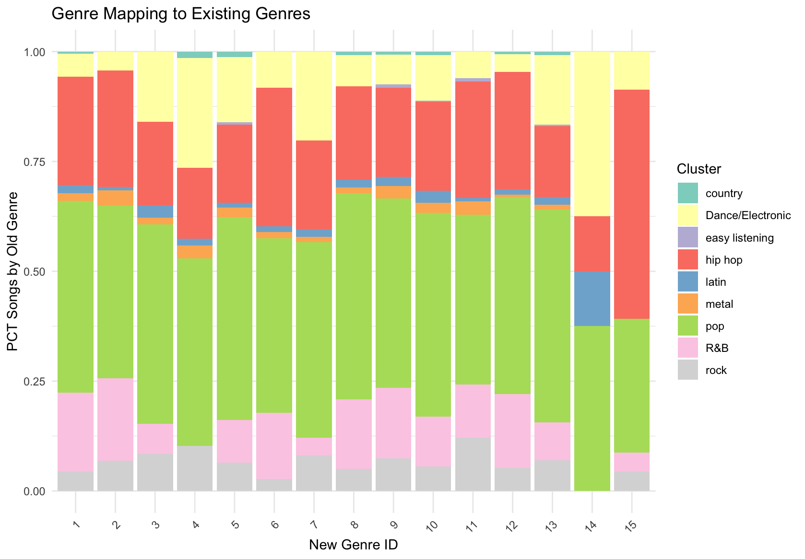
Results - KMeans

Slide 9
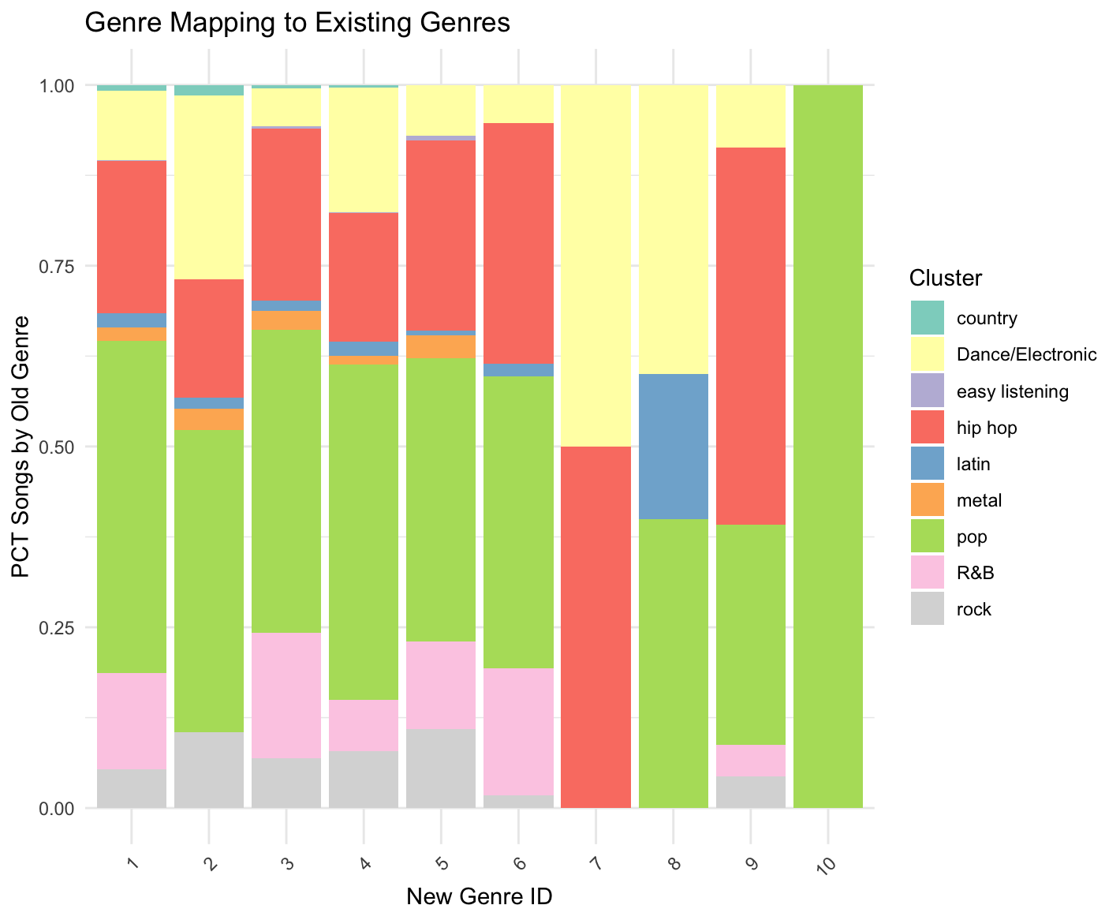
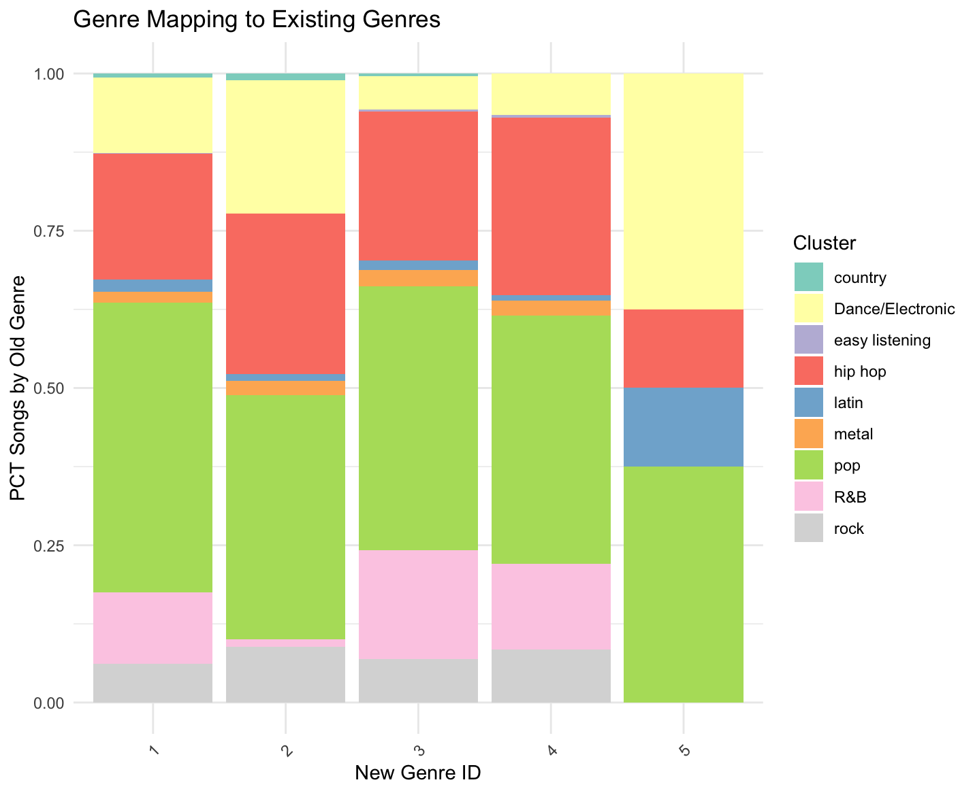
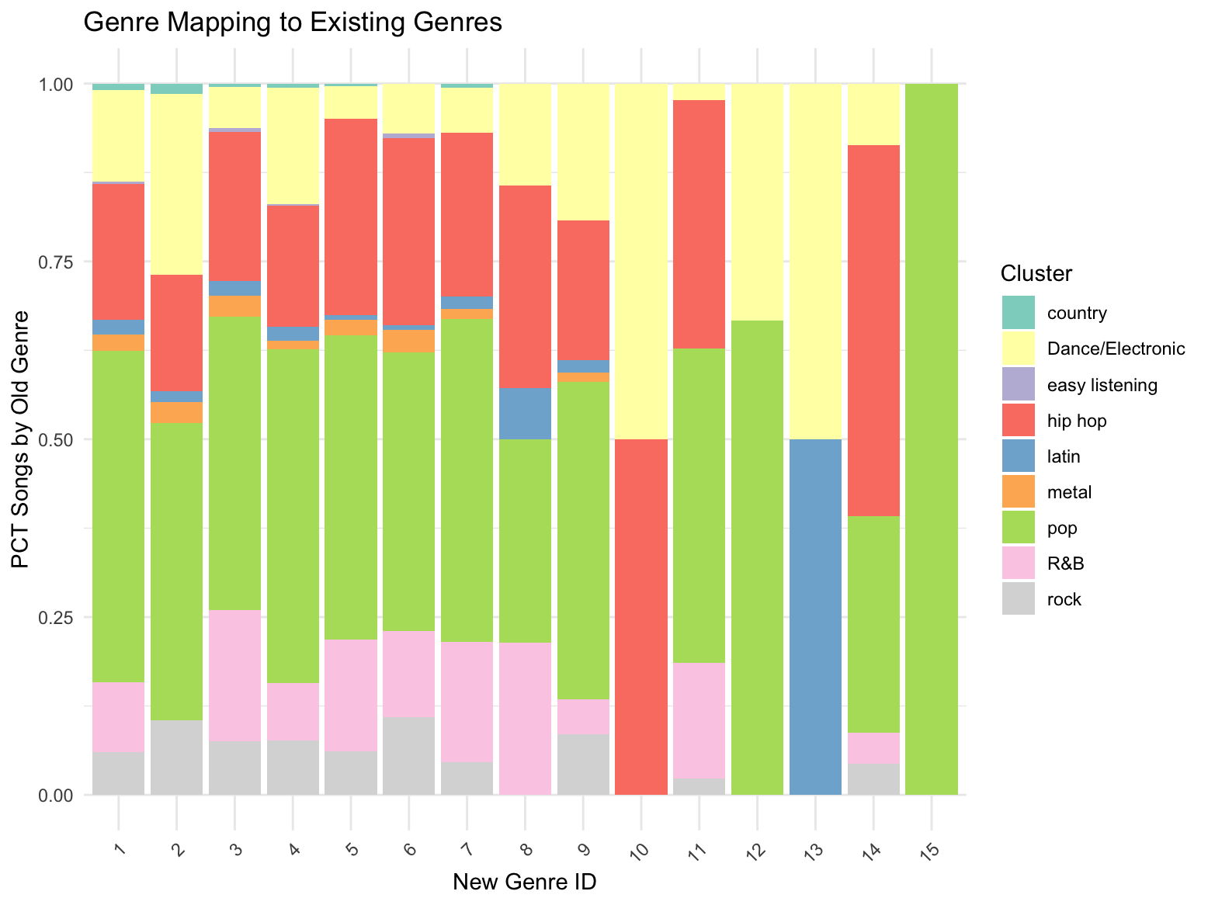
Results - Hierarchical Complete

Slide 10
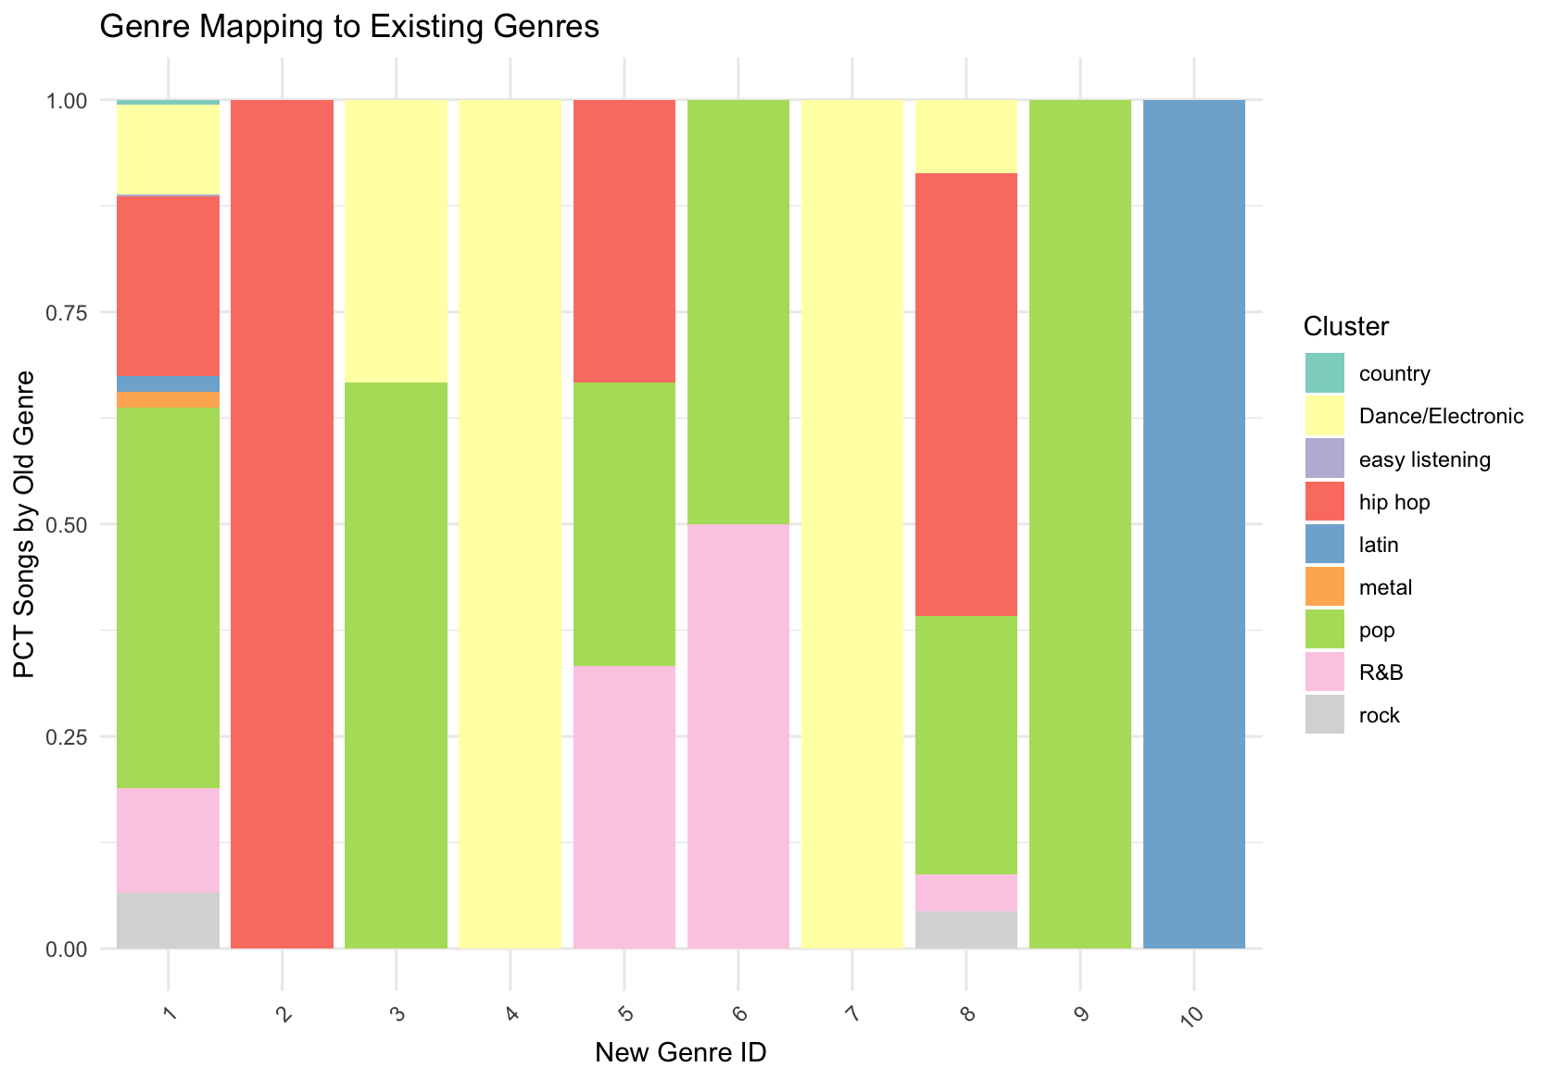
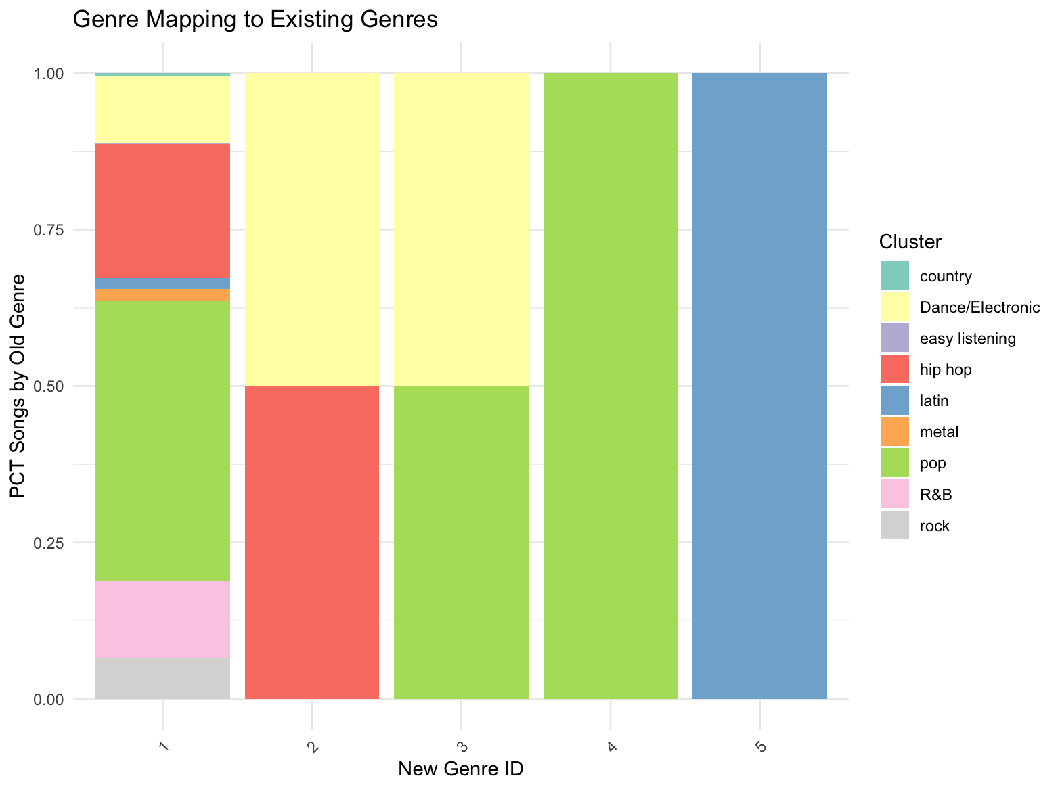
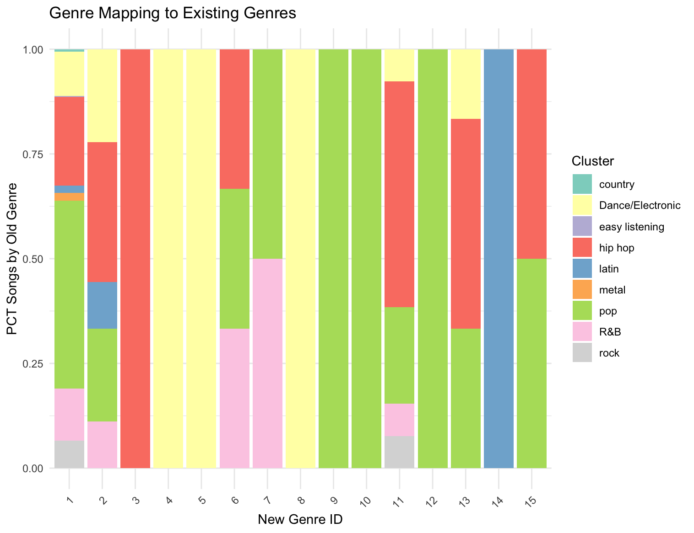
Results - Hierarchical Single

Slide 11
Conclusions
Genres are not based on quantifiable characteristics like those examined in our dataset
K-means did not see any correlation between said characteristics and existing genre
Hierarchical complete clustering often saw entirely pop type genres at higher numbers of clusters
Hierarchical single clustering separates more based on genre and each has more distinct clusters
Many groupings based on features do not follow with the correct cluster
Notes:
Genres are not based on quantifiable characteristics or features like those examined in our dataset
K-means did not see any correlation between said characteristics and existing genre, the clusters were well distributed including (for the most part) similar proportions of each genre
Hierarchical complete clustering often saw entirely pop type genres within higher numbers of clusters, but this is likely due to the overwhelming imbalance of pop within the dataset, leading to some skew
It would be beneficial to include more equally distributed amount of genres to further test the best type of clustering
Single - separates more based on genre and each has more distinct clusters - (i.e. we saw that latin was a well-defined genre, likely because it’s origin and style is so distinct from the otherwise American genres)
Many groupings based on features don’t line up with the clusters, similar songs are not reflected in those genres

